Slide 1
CLASSICAL CONTROL SYSTEMS COE 387

Slide 2
Course Administration
ESE 406/505-MEAM 513 : Control Systems Department of Electrical and Systems Engineering University of Pennsylvania
Spring 2004
Announcements
Course Description: This course is an introduction to analysis and design of feedback control systems,
including classical control theory in the time and frequency domain. Laplace transforms, mathematical modeling of physical processes. Transfer functions, signal flow diagrams, block diagram manipulation. Step, impulse and frequency response of linear systems. Bode Plots, Nyquist Plots, Root locus, Nichol’s chart and application to design of compensators. Feedback, feedforward and tacho feedback compensation. PID control, identification of linear systems, stability of linear systems.
Suggested pre-requisites: Basic course on ordinary differential equations and linear algebra, Knowledge of signals and systems will be an advantage.
Instructor:
Dr. G. S. KLOGO, emial: selormklogo@gmail.com Office hours : N. A
Lectures: Wed. 8am to 10am : EE
Thu. 10am to 12noon : COE
Textbook:
.
References Books:
Modern Control Engineering, 4th Edition, by K. Ogata, Prentice Hall, 2001
Modern Control Systems, 9th Edition, by Dorf and Bishop, Prentice Hall, 2001.
Automatic Control Systems, by B. Kuo, Prentice Hall, 1995.
Feedback Control of Dynamic Systems, by Franklin, Powell and Emami Naieni, 4th Edition, Prentice Hall, 2002
reading sources
R. M. Murray (ed), Control in an Information Rich World: Report of the Panel on Future Directions in Control,
Dynamics, and Systems, SIAM, 2002.
K. J. Åström and Richard M. Murray, Analysis and Design of Feedback Systems, Preprint, 2004.
J. Doyle, B. Francis, and A. Tannenbaum, Feedback Control Theory, McMillan, 1992.
Grading : Midterm I: 15% Midterm II (Mini Project + Presentation): 15% Final Exams 70%
Teaching assistant: George Kwatia email: gkwatia@gmail.com
Notes:
Hand out e-mail list when done

Slide 3
Overview of the Course
Wk | Lecture Days
1 | Introduction to Feedback and Control
2-3 | System Modeling/Analysis, Review of ODEs, and Laplace Transform
4-5 | Stability and Performance
6-7 | Tests for stability
8-9 | Root locus analysis. Design for time domain specs.
10-11 | Frequency Domain Design: Bode plot.
12-14 | Loop Analysis of Feedback Systems. Nyquist criterion
15 | Fundamental Limits on Performance
16 | Uncertainty Analysis and Robustness

Slide 4
Introduction to Control Systems
G(s)
+ _

Slide 5
Brief history of automatic control (I)
1868 First article of control ‘on governor’s’ –by Maxwell
1877 Routh stability criterien
1892 Liapunov stability condition
1895 Hurwitz stability condition
1932 Nyquist
1945 Bode
1947 Nichols
1948 Root locus
1949 Wiener optimal control research
1955 Kalman filter and controlbility observability analysis
1956 Artificial Intelligence

Slide 6
Brief history of automatic control (II)
1957 Bellman optimal and adaptive control
1962 Pontryagin optimal control
1965 Fuzzy set
1972 Vidyasagar multi-variable optimal control and Robust control
1981 Doyle Robust control theory
1990 Neuro-Fuzzy

Slide 7
Control system analysis and design
Step1: Modeling
By physical laws
By identification methods
Step2: Analysis
Stability, controllability and observability
Step3: Control law design
Classical, modern and post-modern control
Step4: Analysis
Step5: Simulation
Matlab/simulink, Fortran, etc….
Step6: Implement

Slide 8
Three eras of control
Classical control : 1950 before
Transfer function based methods
Time-domain design & analysis
Frequency-domain design & analysis
Modern control : 1950~1960
State-space-based methods
Optimal control
Adaptive control
Post modern control : 1980 after
H∞ control
Robust control (uncertain system)

Slide 9
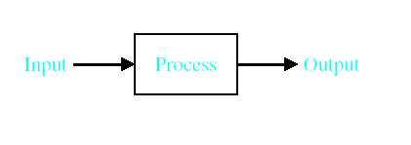

System – An interconnection of elements and devices for a desired purpose.
Control System – An interconnection of components forming a system configuration that will provide a desired response.
Process – The device, plant, or system under control. The input and output relationship represents the cause-and-effect relationship of the process.

Slide 10
Control System Concepts
A system is a collection of components which are co-ordinated together to perform a function.
Systems interact with their environment across a separating boundary.
The interaction is defined in terms of variables.
system inputs
system outputs
environmental disturbances

Slide 11
Signals & systems
Input signals
Output signals
Time system

Slide 12
Systems
Disturbance Inputs
System Outputs
Subsystem
System
Engineering systems
Biological systems
Information systems
Environment
Control Inputs

Slide 13
System Variables
The system’s boundary depends upon the defined objective function of the system.
The system’s function is expressed in terms of measured output variables.
The system’s operation is manipulated through the control input variables.
The system’s operation is also affected in an uncontrolled manner through the disturbance input variables.

Slide 14
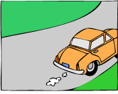
Car and Driver Example
Objective function: to control the direction and speed of the car.
Outputs: actual direction and speed of the car
Control inputs: road markings and speed signs
Disturbances: road surface and grade, wind, obstacles.
Possible subsystems: the car alone, power steering system, braking system, . . .

Slide 15

Antenna Positioning Control System
Original system: the antenna with electric motor drive systems.
Control objective: to point the antenna in a desired reference direction.
Control inputs: drive motor voltages.
Outputs: the elevation and azimuth of the antenna.
Disturbances: wind, rain, snow.

Slide 16
General Control System
Objective
Causing output to track a reference even in the presence of
Measurement noise
Model error
Disturbances
Metrics
Stability
Output remains bounded
Performance
How well an output tracks the reference
Disturbance rejection
Robustness
Ability to tolerate modeling error of the plant

Slide 17
Control System
Control physical system’s output
By setting physical system’s input
Tracking
E.g.
Cruise control
Thermostat control
Disk drive control
Aircraft altitude control
Difficulty due to
Disturbance: wind, road, tire, brake; opening/closing door…
Human interface: feel good, feel right…

Slide 18
Types of control systems
Open-loop:
Closed-loop:

Slide 19
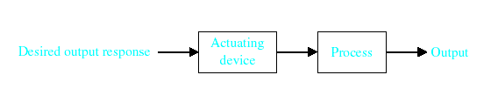

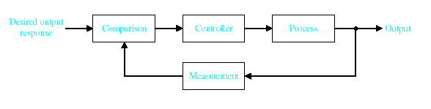

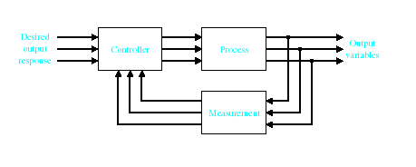
Open-Loop Control Systems utilize a controller or control actuator to obtain the desired response.
Closed-Loop Control Systems utilizes feedback to compare the actual output to the desired output response.
Multivariable Control System

Slide 20
Control system applications

Slide 21
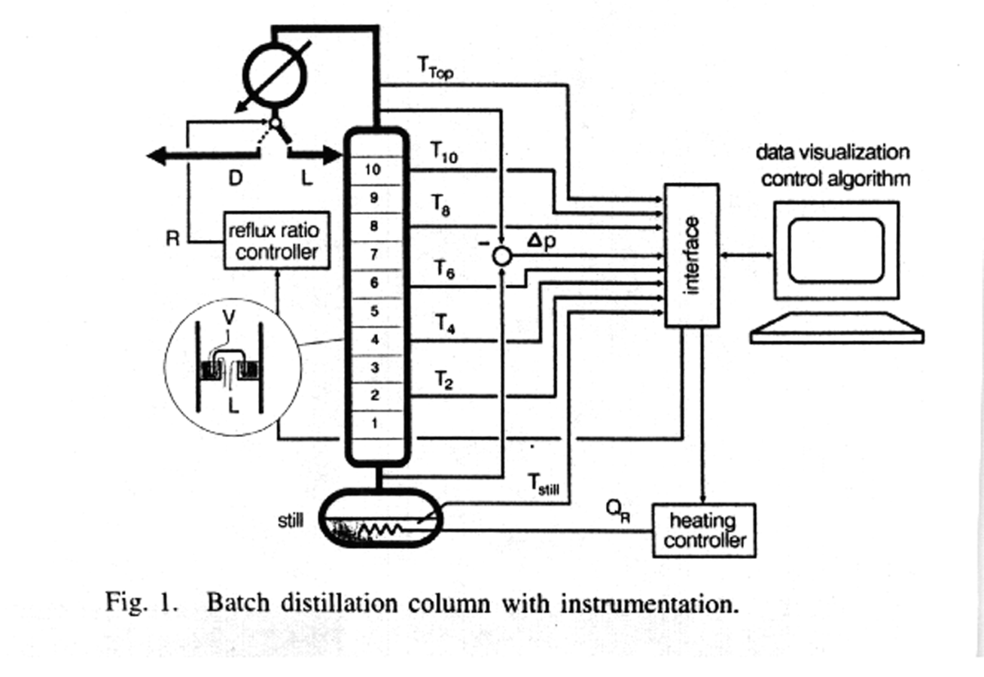
Process Control
From R. Stenz and U. Kuhn, Automation of a Batch Distillation Column Using Fuzzy and Conventional Control," IEEE Transactions on Control Systems Technology, vol. 3, no. 2, June 1995, page 172.

Slide 22
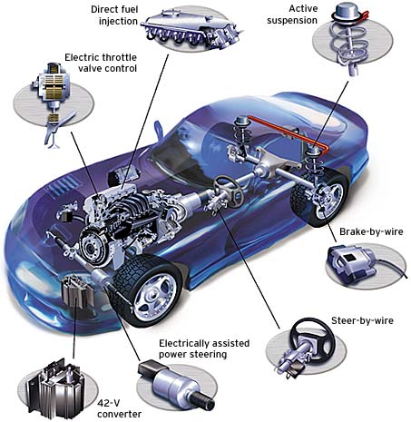
Automotive applications for by-wire
By-wire is the concept Replacing mechanical and hydraulic control mechanisms with an electronic system

Slide 23
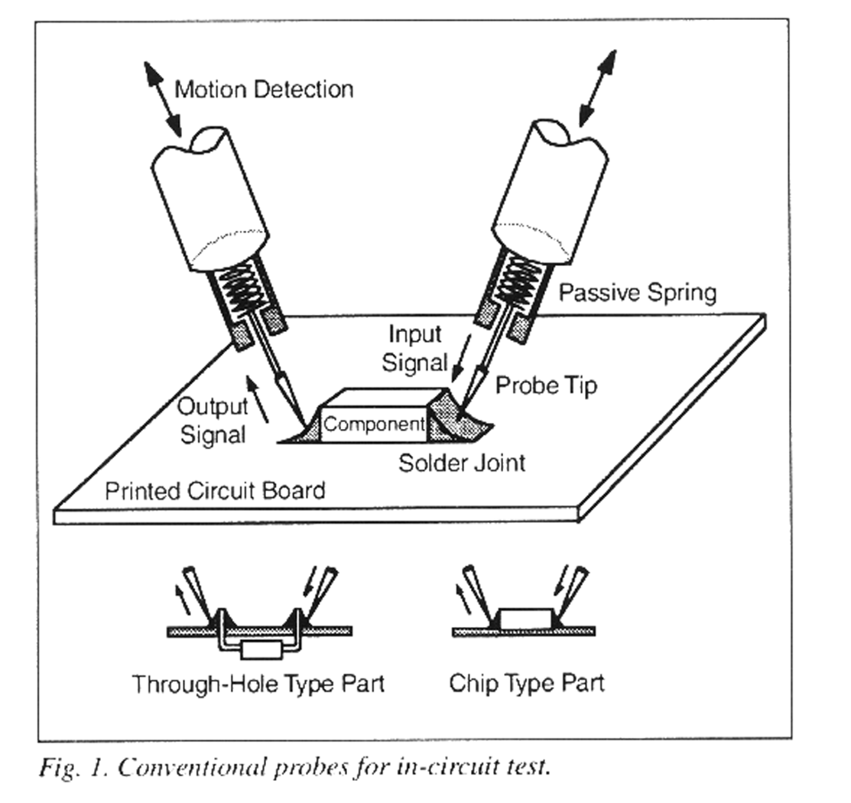
Printed Circuit Board test
From: J. Shim, H. Cho and S. Kim, "An Actively Compliable Probing System," IEEE Control Systems Magazine, vol. 17, no. 1, February 1997, page 15.

Slide 24
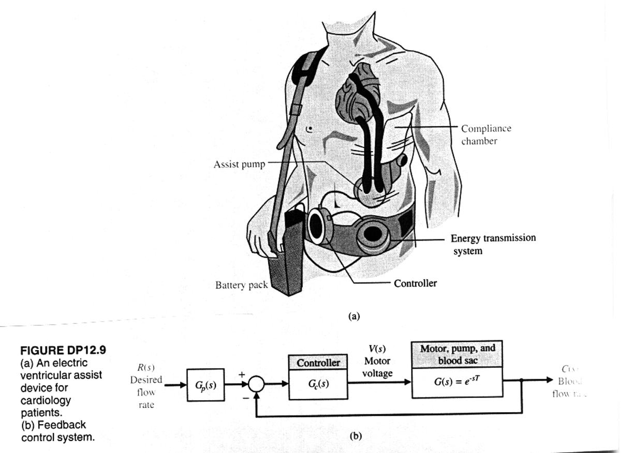
Biomedical
From: R. Dorf and R. Bishop, Modern Control Systems, Addison Wesley, 7th edition, 1995, page 706.

